Slide 1
iCareer HUB Project
Name:Mohamed Magdy Galal
ID:20100352

Slide 2
1-introduction
Overview: iCareer Hub: MENA's pioneering virtual career center by iCareer & Origin. Centralized resources for students, employers, universities, and NGOs. Revolutionizing access to career services via technology iCarrer applied in ain-Shams university and will be apply in all universities very soon
Objective: Transforming MENA's Career Services

Slide 3
2-My Role
1. Designed the project's database architecture
2. Implemented APIs for user registration
3. Implemented APIs for Courses
4. Implemented the employers module

Slide 4



3- Tools

Slide 5



4-Languages used

Slide 6
5-Employer Module Impact
Student and Alumni Experience: Streamlined Job Search
Employer Experience: Effortless Opportunity
Promotion Administrator Benefits: Rich Insights and Management

Slide 7
6-Key Functionalities
Job Post Privileges and Approval Flow
Customizable Job Post Forms
Advanced Search and Filtering
Application Management
Administrator Approval & Access Settings

Slide 8
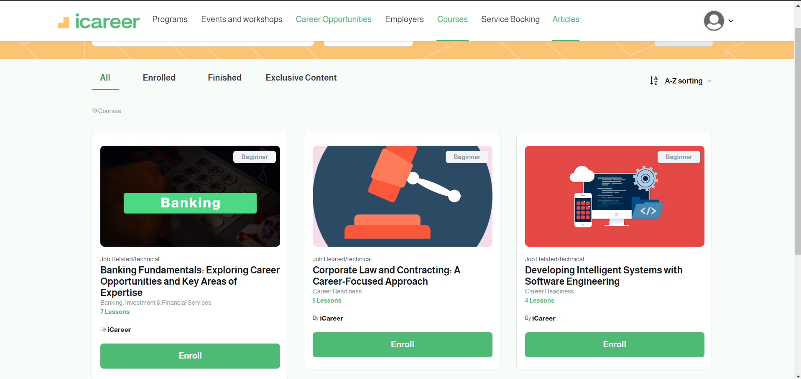
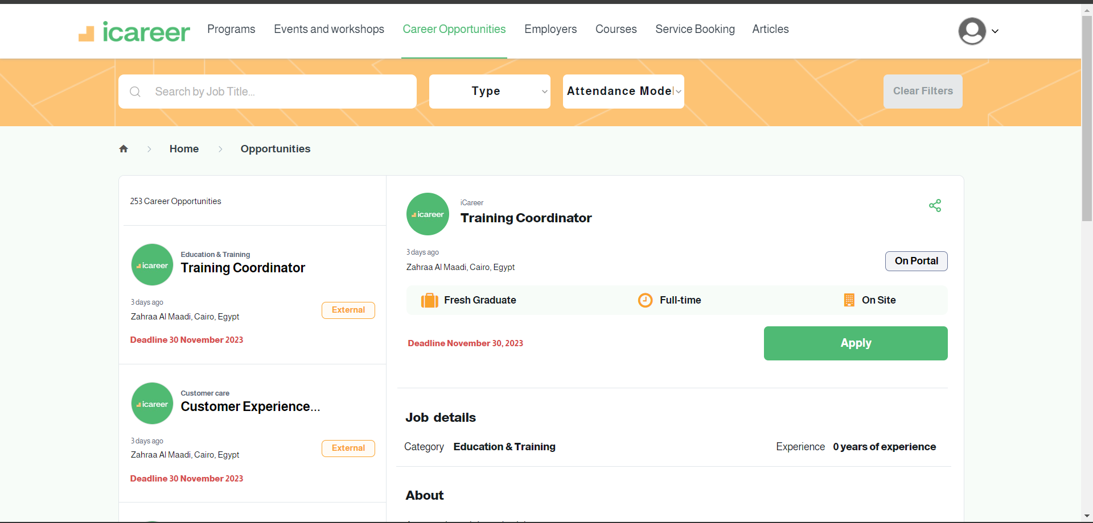
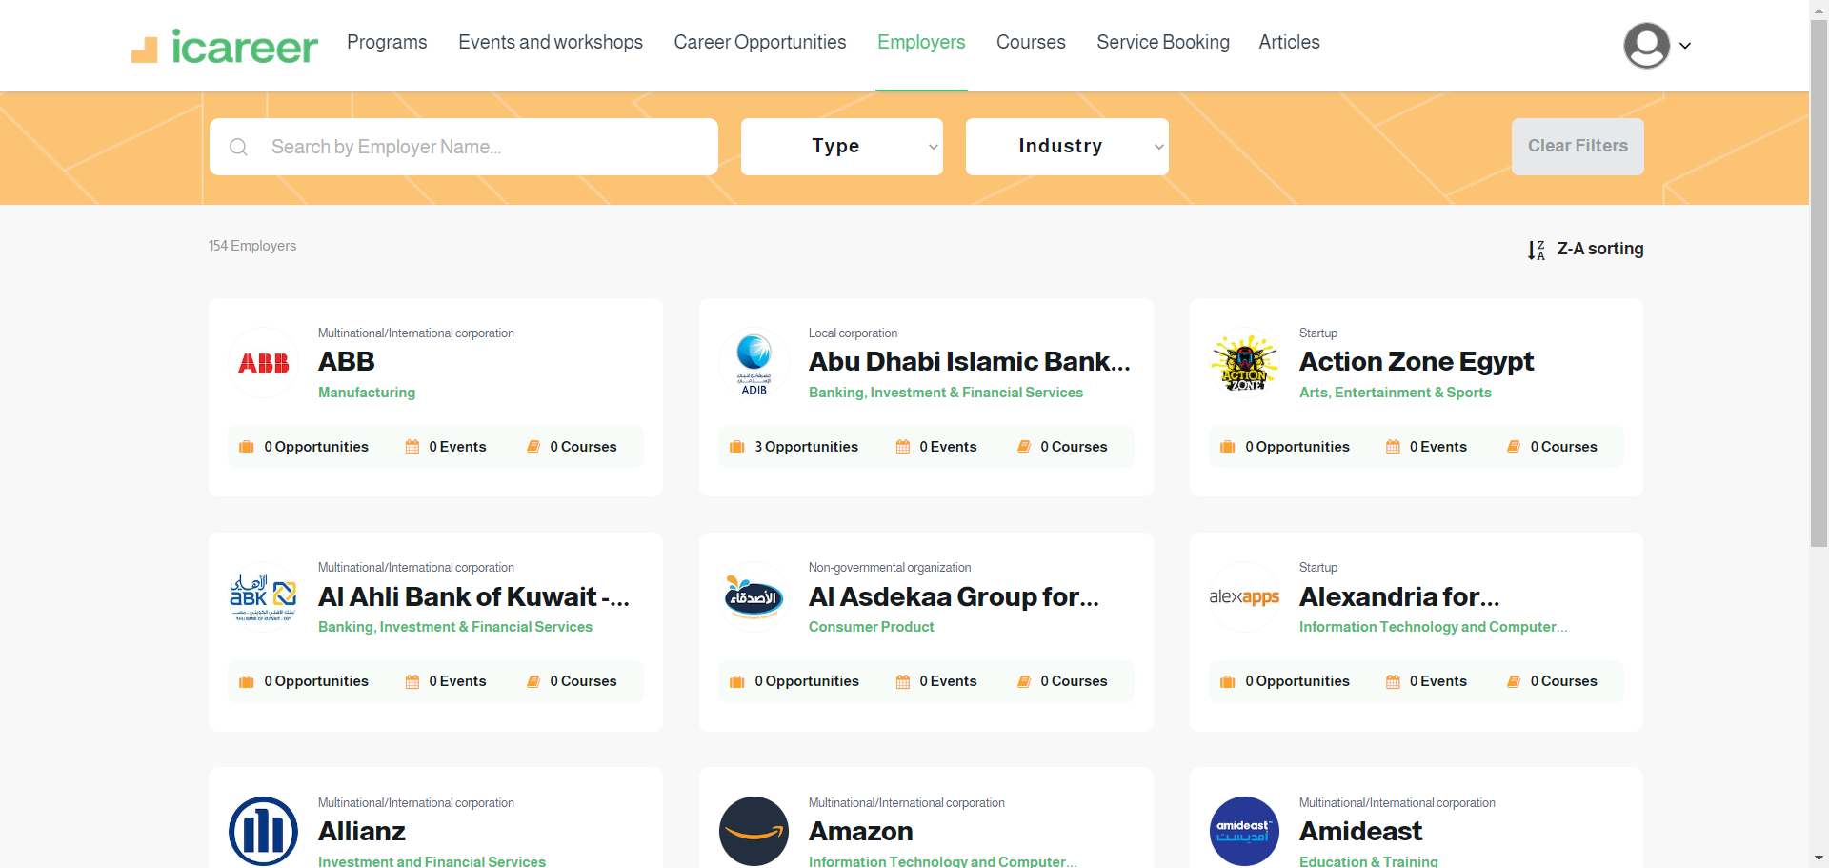

Slide 9
7-Results and Benefits
Improved Employer-Student Engagement
Enhanced Job Search Experience
Efficiency Gains for Career Centers
Data Insights for Future Enhancements

Slide 10
8-Conclusion
iCareer Hub is a pioneering Virtual Career Center in the MENA region, offering comprehensive career services and resources to bridge the gap between academic offerings and labor market requirements. With a range of features such as student and employer

Slide 11
Any Questions?

